Slide 1

A Machine Learning Approach to Photovoltaic System Optimization
Alex, Digonto, Elbert, Konstantin, Nathan
It sure looks sunny!!

Slide 2
Table of contents
01
02
03
04
05
06
Goal
EDA
Models
Results
Limitations
Works Cited/ Appendix

Slide 3
01
Goal
I wonder if it’s sunny…

Slide 4
Goal
2. Map out the most optimal locations for solar farms in the US
Predict energy output of a hypothetical solar farm based on solar irradiance
Produce a heatmap showing locations where solar irradiance is highest
In order to pick the most optimal location for our farm, we will take into consideration transmission losses
Model solar irradiance against a number of meteorological factors
Build multiple models to accurately predict solar energy production

Slide 5

02
EDA
It sure is sunny!!

Slide 6
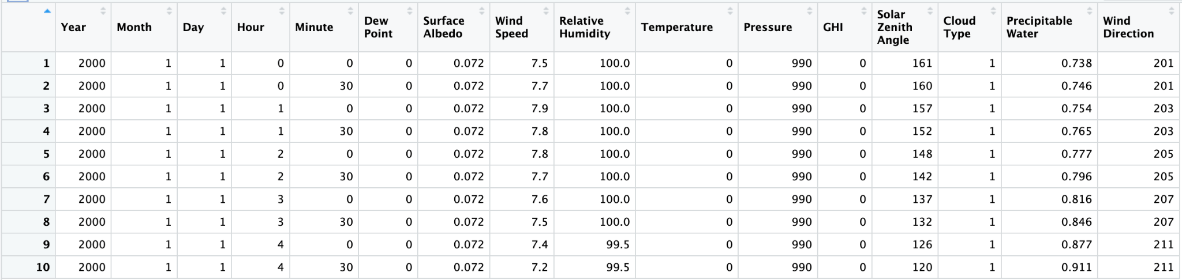
Data
National Solar Radiation Database (NSRDB)
3 different cities (Chicago, Las Vegas, New York)
2000-2020
Response Variable is GHI (Global Horizontal Irradiance)
Solar Irradiance directly proportional to Solar Panel Production

Slide 7
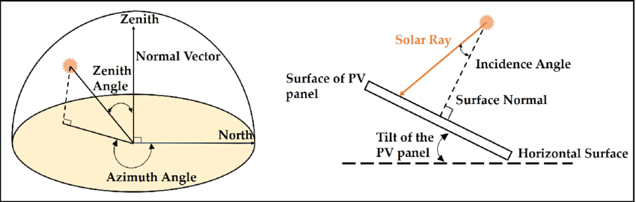

Slide 8
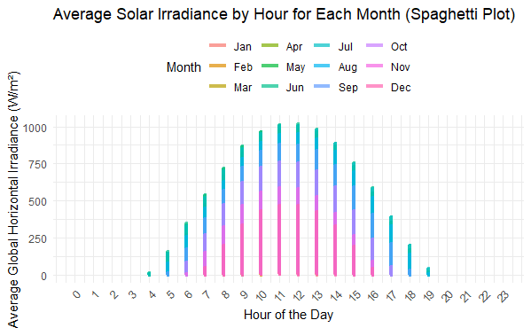
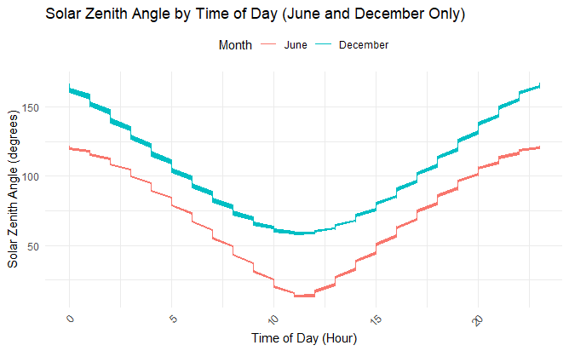
Average Solar Irradiance, Solar Zenith

Slide 9
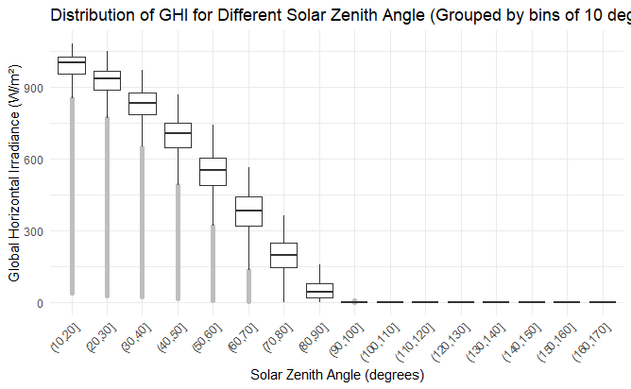
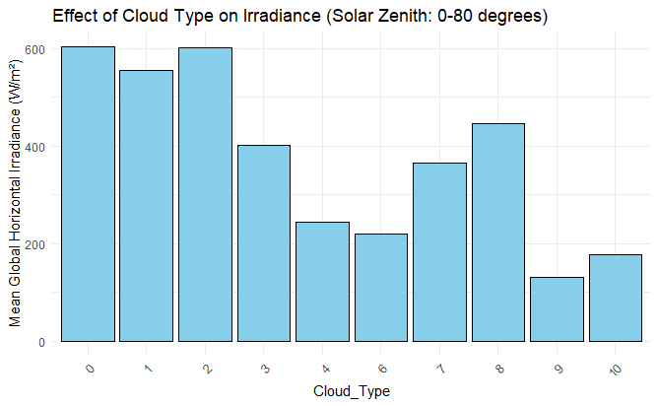
Irradiance vs Zenith Angle, Cloud Type

Slide 10
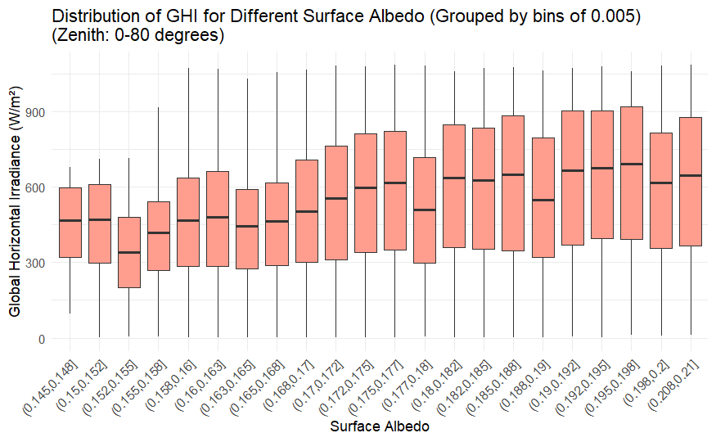
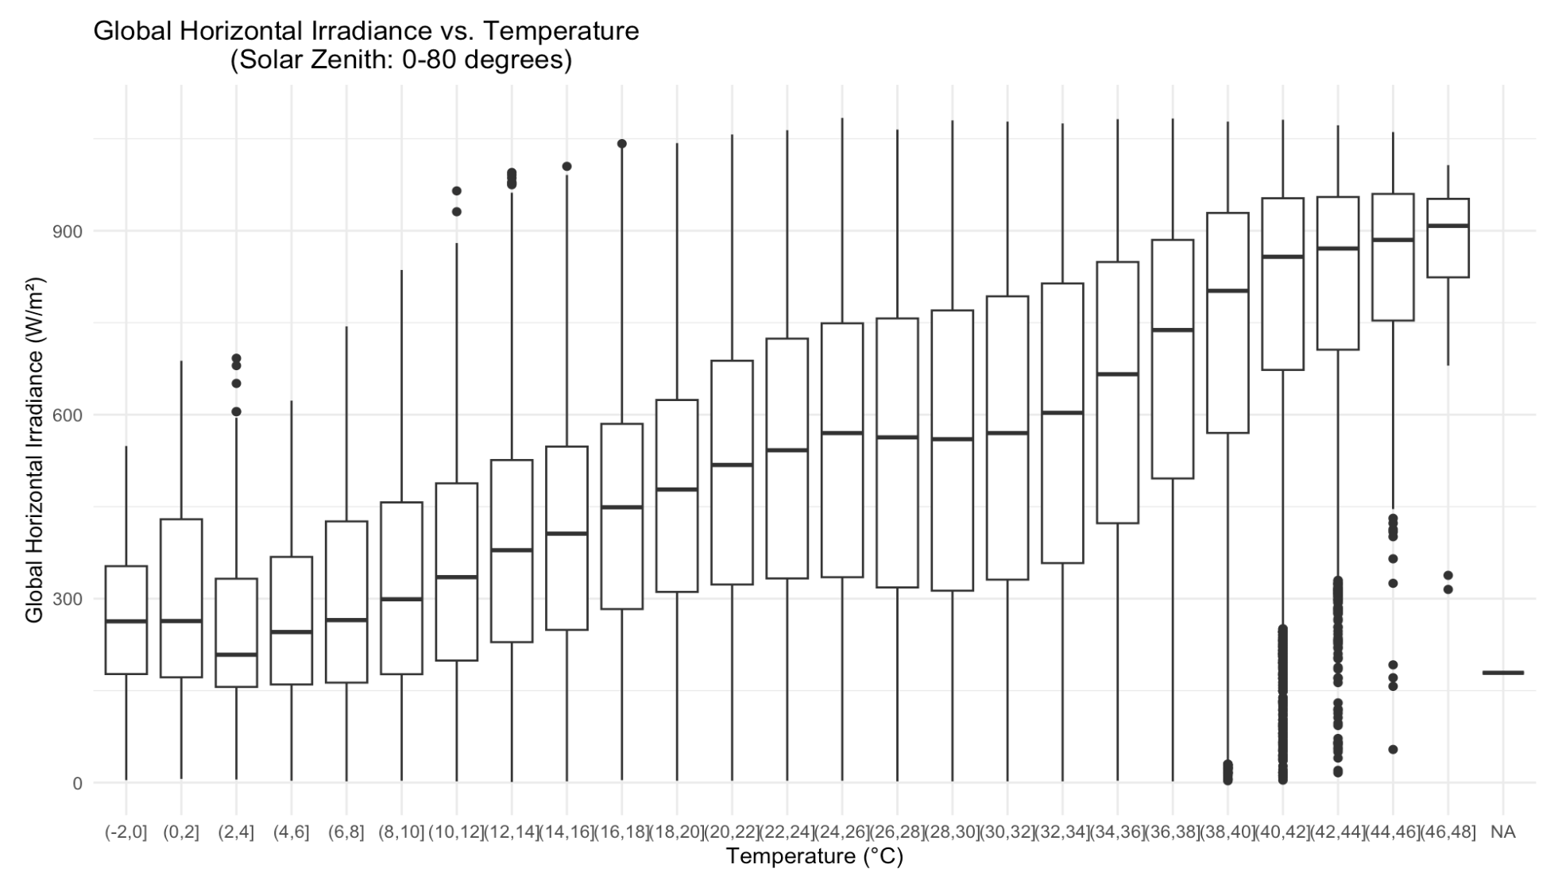
Irradiance vs. Temp, Surface Albedo

Slide 11
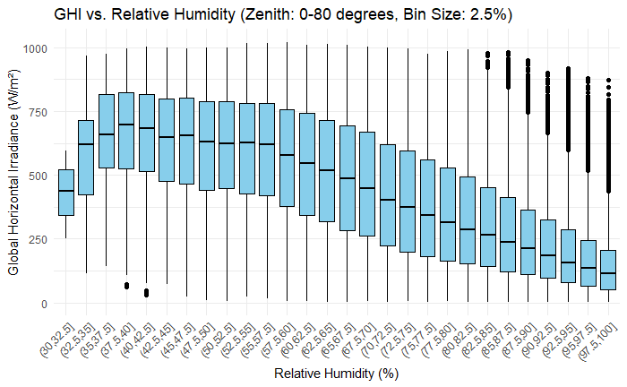
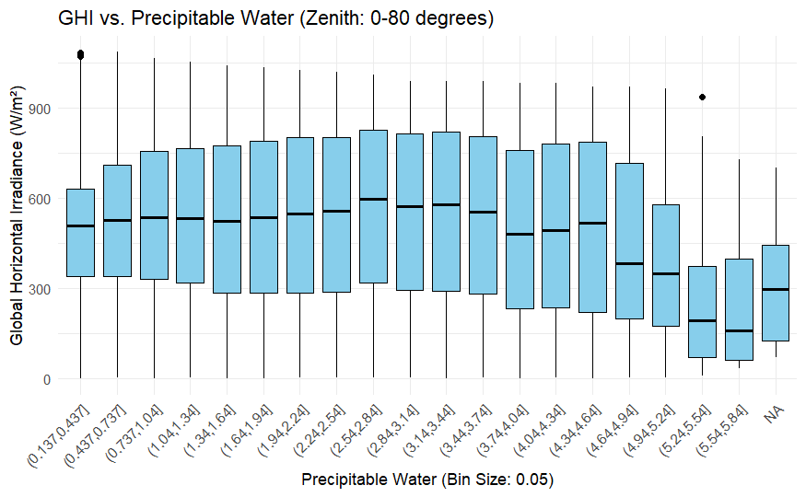
Irradiance vs Humidity, Pr. Water

Slide 12
Cleaning/Preprocessing
Strip out Rows with Zenith Angle above 90
Use Cyclical Encoding for Datetime and Wind Direction
Remove NA and Info Rows
Merge Datasets from the 3 Cities
Use One-hot encoding for categorical variables
Use Min-Max Scaling on all X-Variables

Slide 13
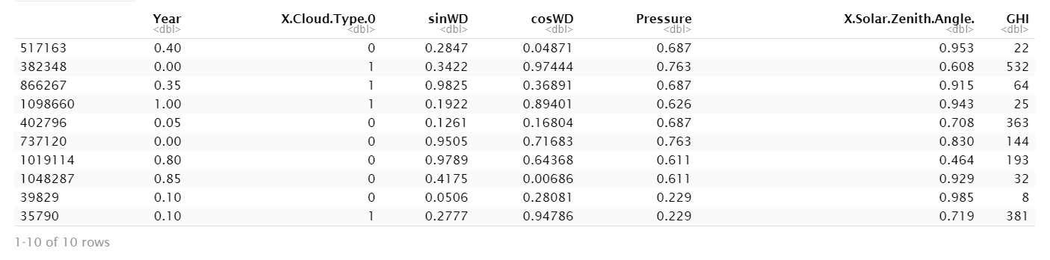
Subset of Processed Data

Slide 14
03
Models
How can I tell if its sunny?

Slide 15

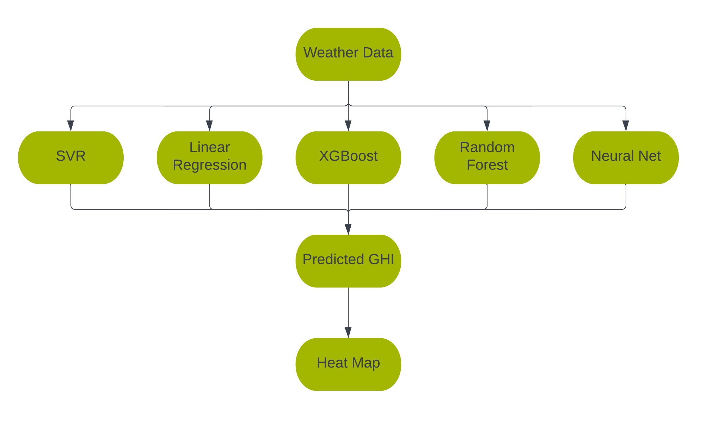
Organizational Chart
Weather Data
formula
Power output
Notes:
Elbert

Slide 16
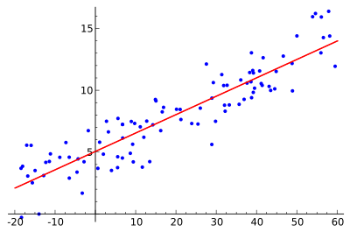
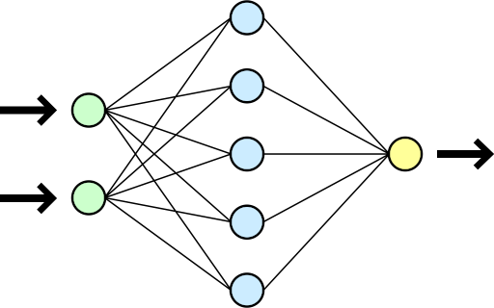
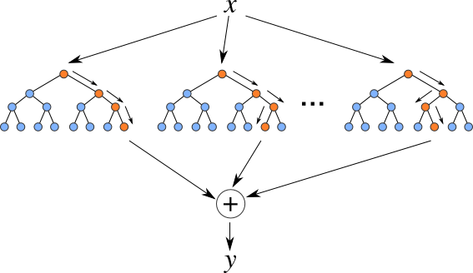
Models Used
Linear Regression
Neural Network
Random Forest
XGBoost
Support Vector Regression (SVR)
Notes:
Elbert

Slide 17
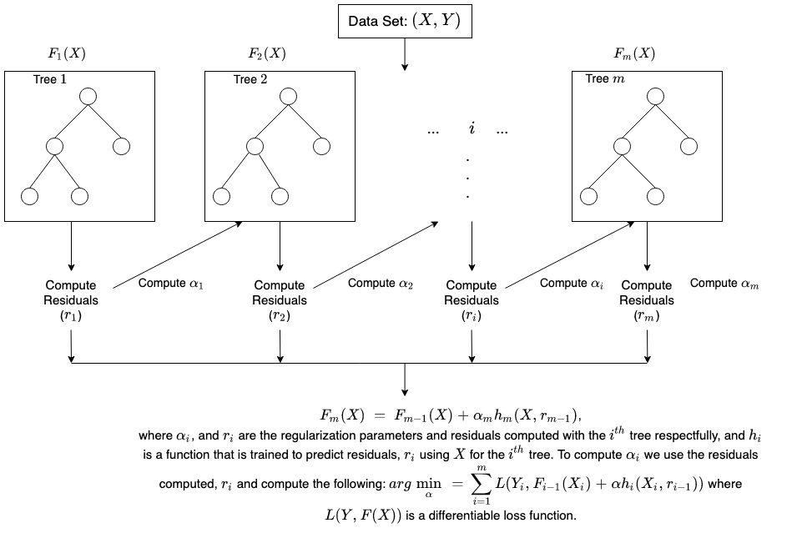
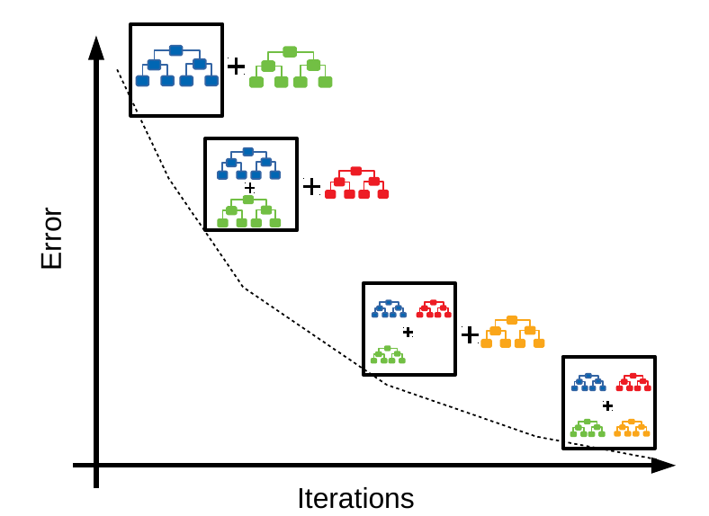
XGBoost

Slide 18
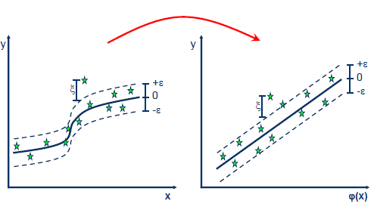
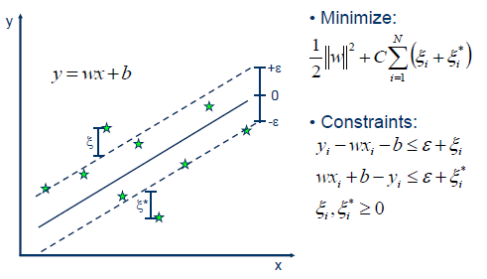
SVR
Notes:
The error things are called support vectors and epsilon is a hyperparameter set beforehand
Write out how to explain SVR

Slide 19
04
Results
It’s definitely sunny.

Slide 20
Comparing Models
It sure is sunny!
 | RMSE | R² | Advantages | Disadvantages
XGBoost | 62.785 | 0.952 | Fast to Train | Many Hyperparameters
Random Forest | 70.237 | 0.884 | Simple to Setup | Slow to Train Big Model
Support Vector Regression | 71.072 | 0.882 | Simple to Setup | Slowest to Train O(n^3)
Neural Net (2HL) | 74.87 | 0.932 | Flexible | Inadequate
Linear Regression | 104.149 | 0.868 | Fastest to Train Easy to Interpret | Inaccurate
Notes:
Elbert

Slide 21
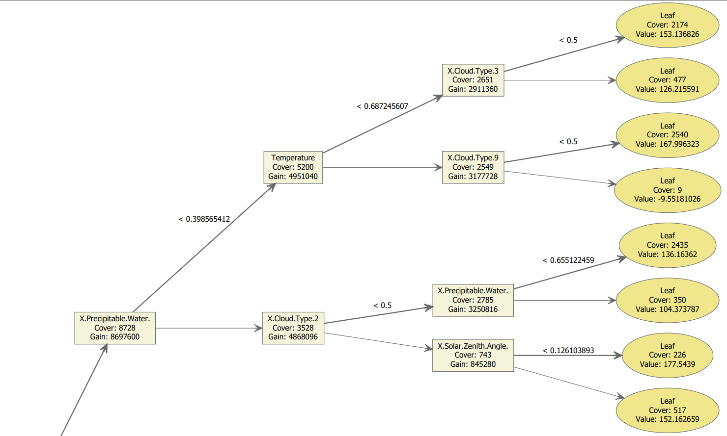
Notes:
Elbert

Slide 22
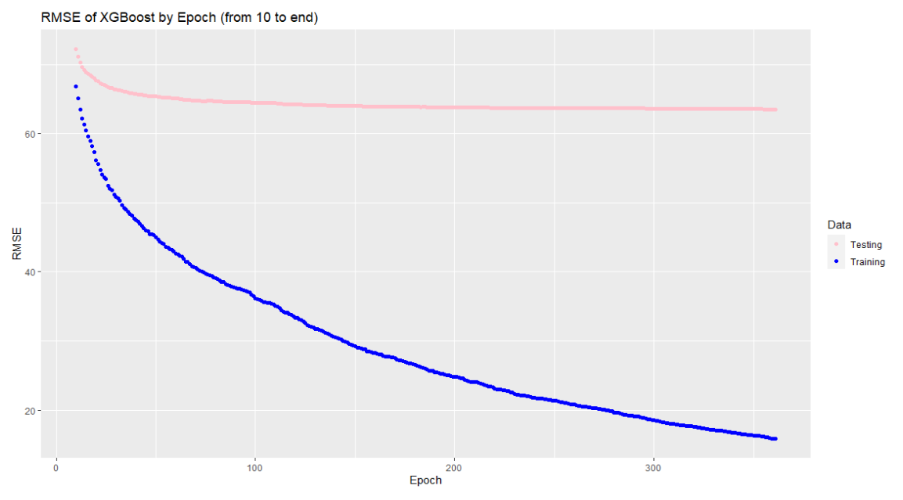
Notes:
Mention that it decreases very quickly because good at overfitting

Slide 23
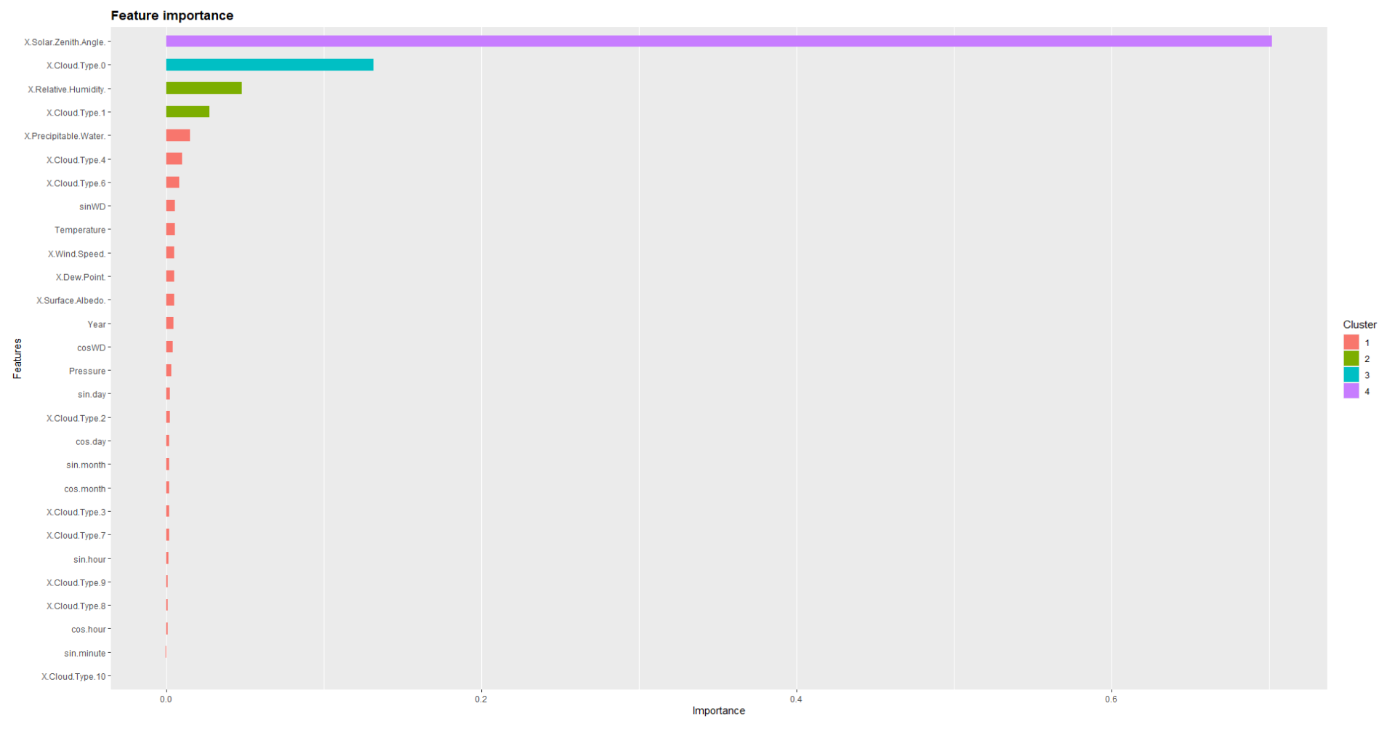
It sure is sunny!!

Slide 24
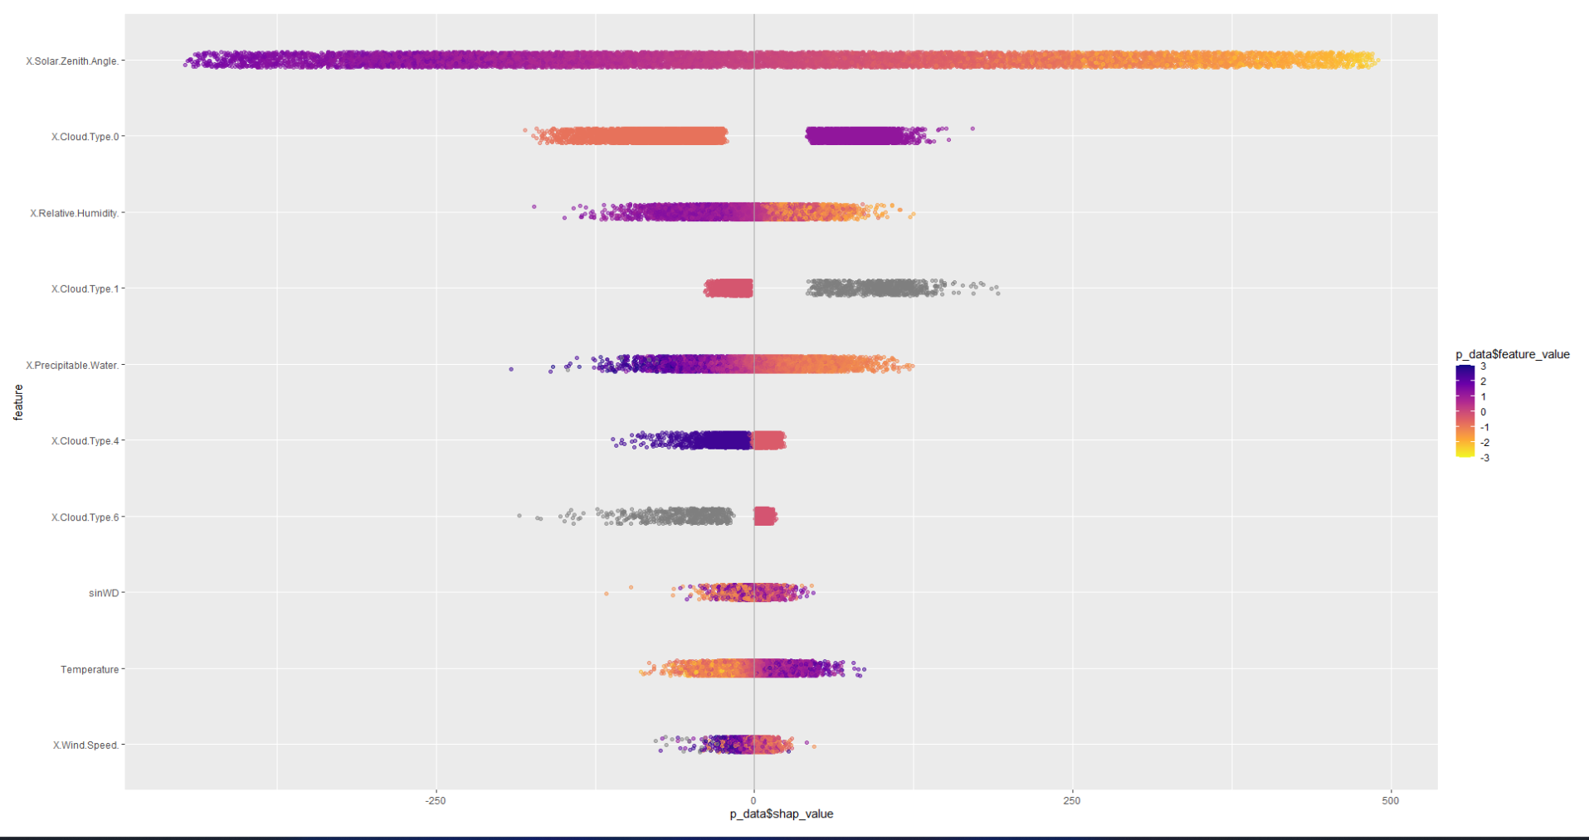

Slide 25
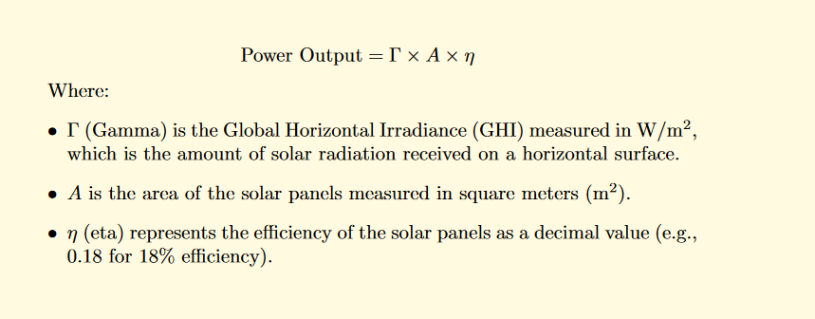
Using GHI to Compute Power Output
To calculate power output from GHI, a simple formula can be utilized.

Slide 26
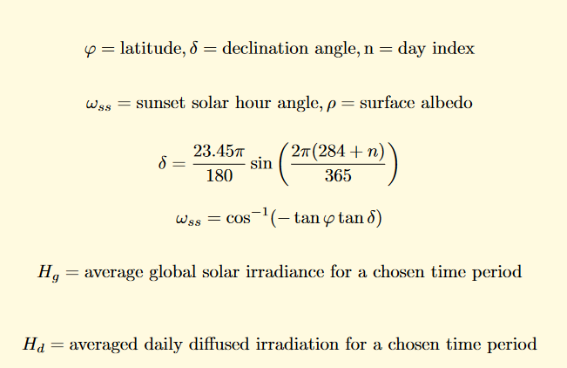
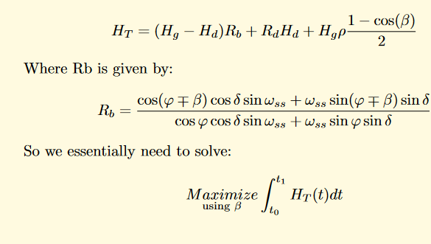
Optimal Tilt for Solar Panels

Slide 27
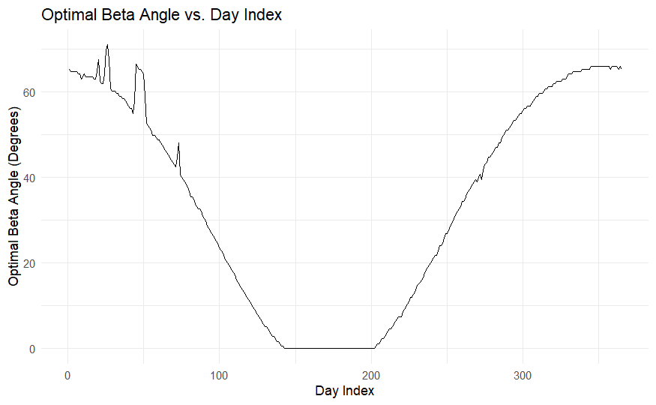
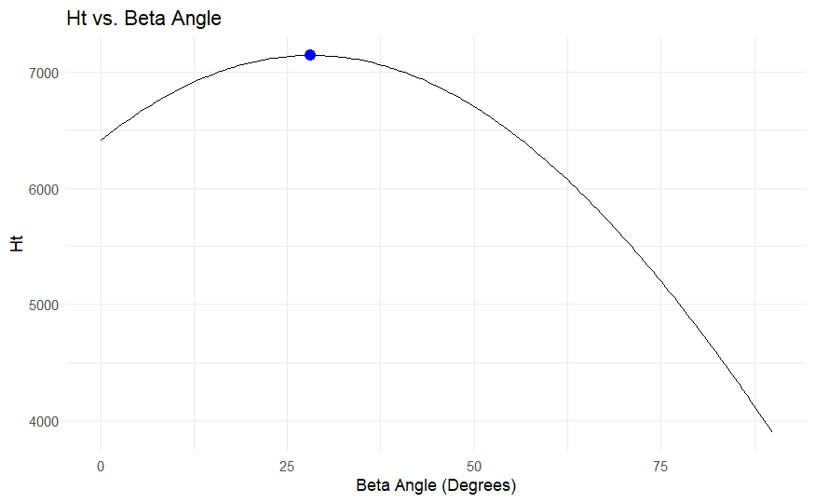
Impact of tilt on output
7146
28.1

Slide 28
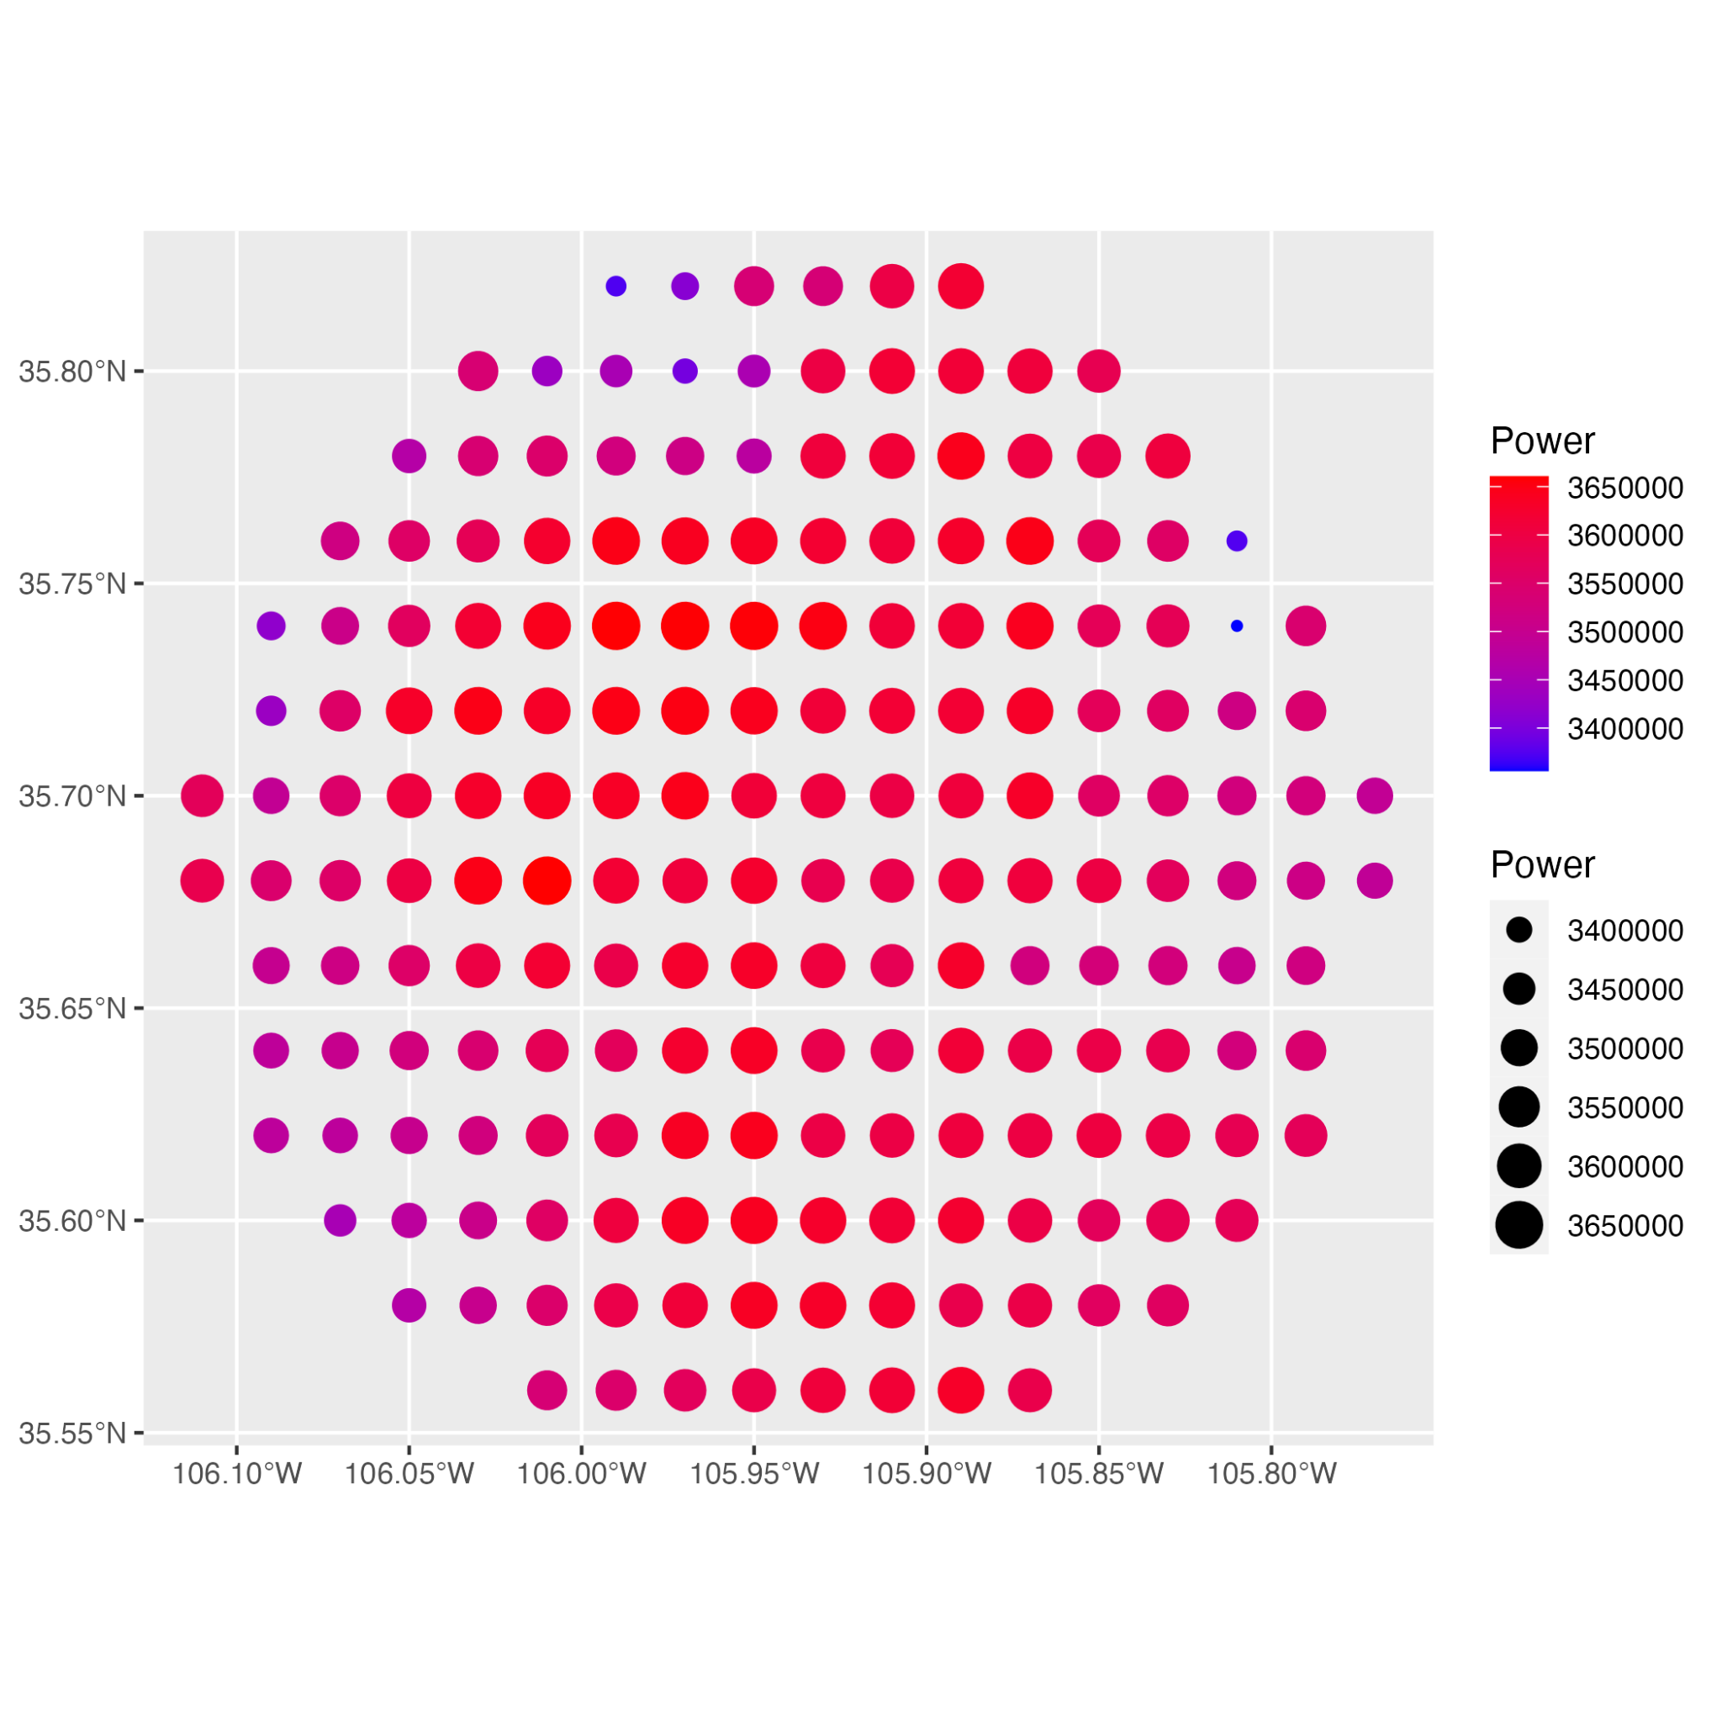
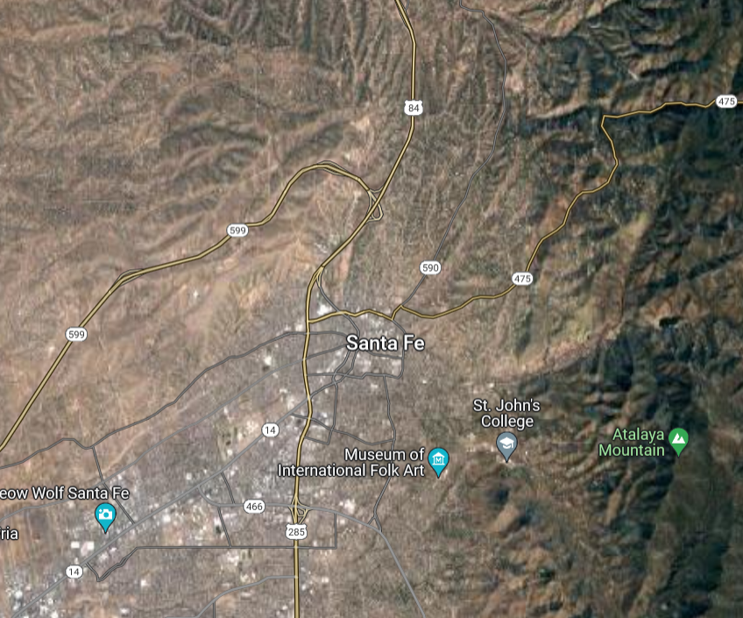

Slide 29
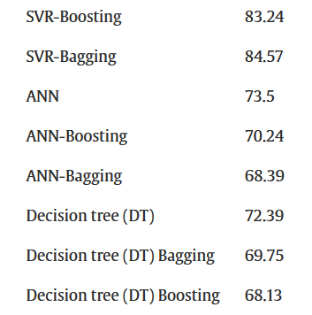


Conclusions
XGBoost has least RMSE and fast training (and its RMSE is comparable to other models used in research)
A general prediction model for solar irradiance could be made using data from more locations
The most impactful variables on solar irradiance are the ones related to sky clarity
The optimal placement of solar panels also depends on geographical features
It’s always sunny in Philadelphia!

Slide 30

05
Limitations
Maybe it’s not sunny after all…

Slide 31
Limitations
Assuming optimal tilt and constant efficiency solar panels
Optimal locations depend on other factors
population density
wildlife habitat
May be hard to predict due to large variability in weather
Not the best at generalizing

Slide 32
06
Works Cited/Appendix
Who said it was sunny?

Slide 33
Works Cited
Sengupta, M., Y. Xie, A. Lopez, A. Habte, G. Maclaurin, and J. Shelby. 2018. "The National Solar Radiation Data Base (NSRDB)." Renewable and Sustainable Energy Reviews 89 (June): 51-60.
Neha Sehrawat, Sahil Vashisht, Amritpal Singh,
“Solar irradiance forecasting models using machine learning techniques and digital twin: A case study with comparison”, International Journal of Intelligent Networks, Volume 4, 2023, Pages 90-102, ISSN 2666-6030,
https://doi.org/10.1016/j.ijin.2023.04.001.
S. Akhlaghi, M. Sarailoo, M. Rezaeiahari and H. Sangrody, "Study of sufficient number of optimal tilt angle adjustment to maximize residential solar panels yield," 2017 IEEE Power and Energy Conference at Illinois (PECI), Champaign, IL, USA, 2017, pp. 1-5, doi: 10.1109/PECI.2017.7935747.

Slide 34


Appendix
It sure is sunny!!
Cloud Types:
0: Clear
1: Probably Clear
2. Fog
3. Water
4. Super-Cooled Water
5. Mixed
6. Opaque Ice
7. Cirrus
8. Overlapping
9. Overshooting
10. Unknown
How many of these were you able to spot? (not including this one)
If you spotted 24 you win!! Scan this for a secret Easter Egg.

